Slide 1
Continuous Testing

Slide 2
Agenda
Overview of Continuous Testing
Functional vs Non-Functional Testing
Overview of Functional Testing
Working with Junit
Overview of Selenium
Working with Selenium
Overview of Non-Functional Testing
Working with Jmeter
Working with BlazeMeter

Slide 3
Continuous Testing
Process of evaluating the functionality of a software application to find any software bugs
It checks whether the developed software met the specified requirements and identifies any defect in the software in order to produce a quality product
It is basically executing a system in order to identify any gaps, errors, or missing requirements contrary to the actual requirements
Types of Continous Testing:
Functional Testing : Type of testing which verifies that each function of the software application operates in conformance with the requirement specification
Non Functional Testing: Type of software testing to test non-functional parameters such as reliability, load test, performance and accountability of the software. The primary purpose of non-functional testing is to test the reading speed of the software system as per non-functional parameters.

Slide 4
Functional vs Non-functional
Parameters | Functional | Non-functional testing
Execution | It is performed after functional testing.
Focus area | It is based on the customer's requirements. | It focusses on customer's expectations.
Requirement | It is easy to define functional requirements. | It is difficult to define the requirements for non-functional testing.
Usage | It helps to validate the behavior of the application. | It helps to validate the performance of the application.
Objective | Carried out to validate software actions. | It is done to validate the performance of the software.
Requirements | Functional testing is carried out using the functional specification. | This kind of testing is carried out by performance specifications
Manual testing | Functional testing is easy to execute by manual testing. | It's very hard to perform non-functional testing manually.

Slide 5
Functional vs Non-functional
Parameters | Functional | Non-functional testing
Functionality | It describes what the product does. | It describes how the product works.
Example Test Case | Check login functionality. | The dashboard should load in 2 seconds.
Testing Types | Examples of Functional Testing TypesUnit testing Smoke testing User Acceptance Integration Testing Regression testing Localization Globalization Interoperability | Examples of Non-functional Testing TypesPerformance Testing Volume Testing Scalability Usability Testing Load Testing Stress Testing Compliance Testing Portability Testing Disaster Recovery Testing

Slide 6
Advantages of Functional Testing
Functional testing is important as it verifies that the system is fixed for release and it is error free.
It ensures the below :
Customer or end- user is satisfied.
Produces a defect-free product/software.
Ensures all the requirements should be met.
Proper working of all the functionalities of an application/software/product.
Software/Product works as expected.
Security and Safety.

Slide 7
Working with Functional Testing
Use test data to identify the inputs.
Determine the expected outcome based on those inputs.
Run test cases with the proper inputs.
Compare actual results with expected results

Slide 8
Functional Testing Types
Unit Testing
Unit testing is done at the initial stages to assure that each block of code/unit performs its intended manipulation of inputs into desired outputs for the next module. Tests an individual unit/component of software to validate that each unit of the software performs as designed.
Integration Testing
Takes multiple individual units/component of the software and tests them as a group to ensure that the unit modules connect as expected and convey data and commands throughout the system per the specifications built.
Smoke Testing
Smoke Testing is a software testing process that determines whether the deployed software build is stable or not
Regression Testing
Verify that the later feature additions and bug fixes not adversely affect existing features.It is full or partial selection of already executed test cases which are re-executed to ensure existing functionalities work fine.
User Acceptance Testing
This the last step before software goes live, user acceptance tests make sure it can handle required tasks in Real- World scenarios, according to specifications. End users typically perform these tests during the Beta testing period.

Slide 9
Functional Testing tools
Some of the top Functional testing tools are given below
Ranorex
Selenium
TestIO
Telerik
CUIT

Slide 10
Testing Java applications using JUnit framework

Slide 11
What is JUnit framework?
A framework for testing “units” in Java applications.
It is part of a family of unit testing frameworks called xUnit.
Became an important part on test-driven development in software.
Requirements are translated in small specific test cases.
The tests grants reliability and confidence of software designs and helps to detect parts of the code that does not meet the requirements.
The tests can be also used for debugging purposes

Slide 12
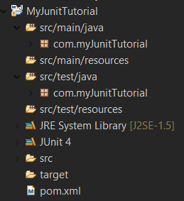
How to create a Unit test?
Unit test needs a special project structure (automatically created with Maven)
Create a Maven project in Eclipse (File -> New -> Other -> Maven Project)
Activate “Create a simple project”
For Group id choose “com.myJunitTutorial” and in Artifact id “MyJunitTutorial”

Slide 13
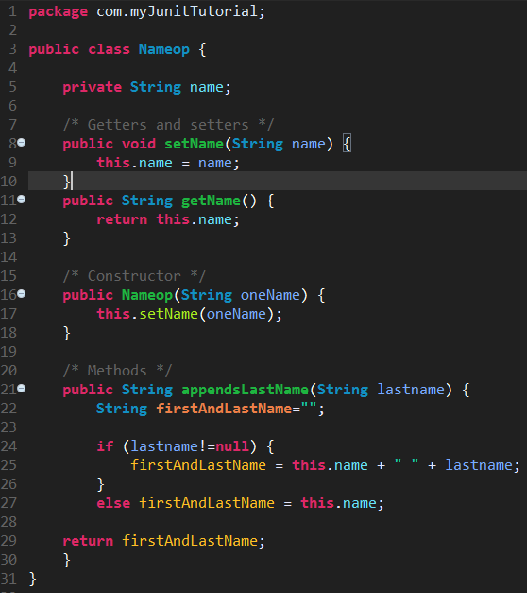
How to create a Unit test?
Write a Java Class for appending First Name and named as Nameop.java as shown in the screenshot

Slide 14
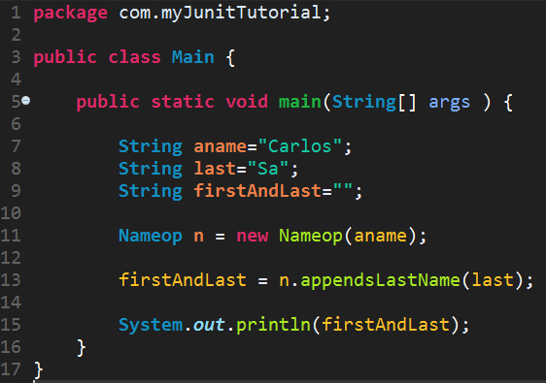
How to create a Unit test?
Write a Java Class named as Main which uses the Java Class Nameop.

Slide 15
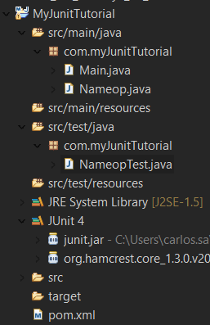
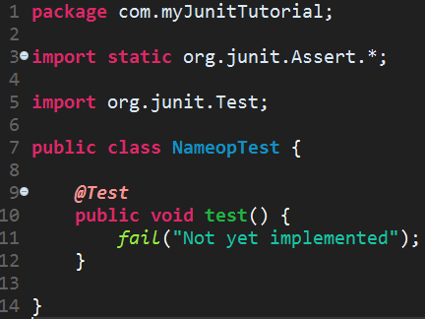
How to create an Unit test?
src/test/java/com.myJunitTutorial (right click) -> New -> “JUnit Test Case”
Use “Test” after name of the tested class (convention)
NameopTest.java

Slide 16
How to create a Unit test?
One can manually add a recent version of JUnit into the Build Path.
We are going to use:
J2SE – 1.5 (JRE 1.8)
JUnit 4.12
Some older versions of JUnit does not use @Test annotation by default to specify a test. An extension of TestCase class is used instead.
Be aware of some conventions used when creating tests.
Unit testing is based on the logic: “If no failure occurs, the test is successful”

Slide 17
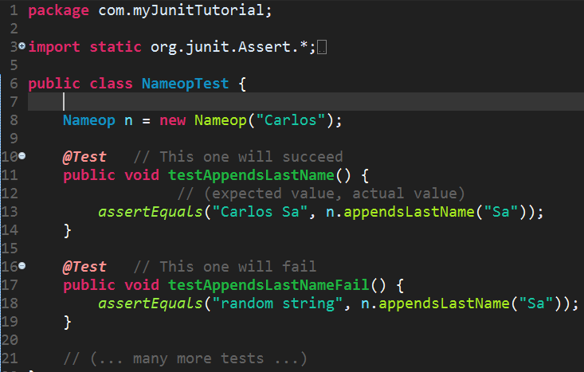
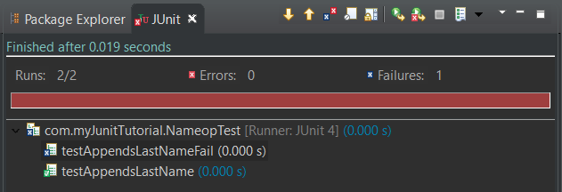

Creating test methods: the first test
Testing methods for Nameop class
Righ Click -> Run As -> JUnit Test Case
The test appendsLastNameTestFail failed because the returned value of n.appendsLastName(“Sa”) does not match the expected result.

Slide 18
JUnit conventions
The annotation @Test specifies a test method. The name of test methods should have the same name of original tested method preceded by “test” and followed by an “_” to specify the condition that is being made within a test.
The source code is not mixed with test code:
In /src/main/java you maintain your code to be tested
In /src/test/java you maintain the created tests
Use inline expressions in test methods arguments (assert methods of JUnit API for example) instead of passing variables.
Each test method should be public void.
Do not use multiple assert or other test methods within a test.

Slide 19
Grouping tests into Suites
A project can have a huge number of test case classes.
Some of the tests can be logically grouped.
Test Suites are a way of grouping tests that follows a common logic:
Divide tests taking in account their specificity. Allows a logic separation.
Detach heavier tests from others. Allows the execution of the test environment restricted to lightest tests, or heaviest ones.

Slide 20
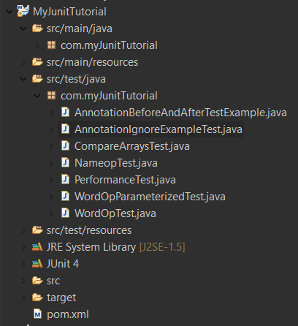
Grouping tests into Suites
Whenever Run As -> JUnit Test in com.myJunitTutorial, all tests inside the package will run.
It is possible to limit the test execution only to some of the specific tests in a Test Suite.
Create a Test Suite:
Right click over com.myJunitTutorial -> New -> Other -> JUnit Test Suite.
Choose the Test Cases classes to include in the suite in the window.
A new Test Suite (java file) will be created.

Slide 21
Good Practices in Unit Testing
One @Test should have only one purpose (one condition per test). Do not test multiple aspects in the same test.
Follow the conventions about test class naming;
Always separate your source code from testing code.
Make sure that a test only fails when there is a failure. Abstract the dependencies from external sources. If a test fails because of an external source changed his behavior, the test becames not useful in fact.
Cover all possible scenarios in each test to assure the correctness of the methods.
When using JUnit for performance evaluation, take in consideration the platforms where the tests will run for choosing timeout wisely.

Slide 22
Automation Testing using Selenium

Slide 23
What is Selenium?
Open-source and a portable automated software testing tool for testing web applications.
It has capabilities to operate across different browsers and operating systems.
Selenium is a set of tools that helps testers to automate web-based applications more efficiently.
Fast and easy to use even with large sets of data with great accuracy
Directly runs scripts for any web browser to automate the web applications and test it

Slide 24
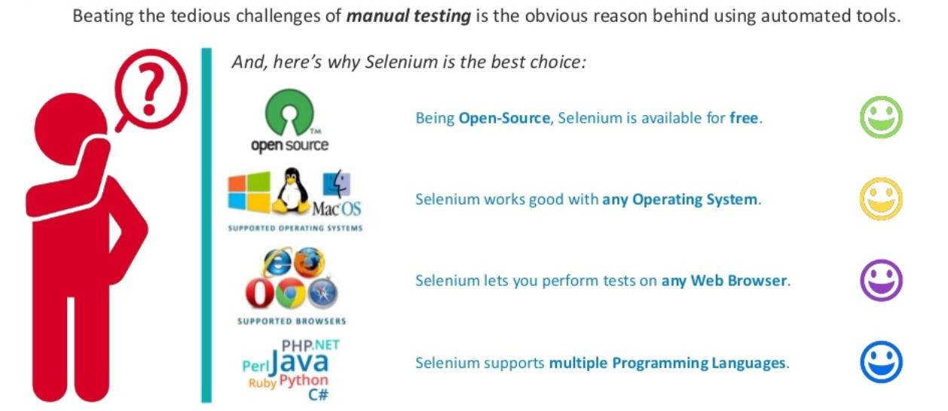
Selenium Features

Slide 25
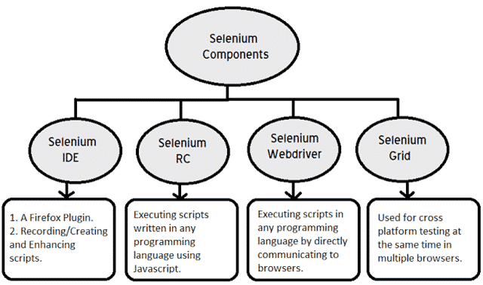
Selenium Components

Slide 26
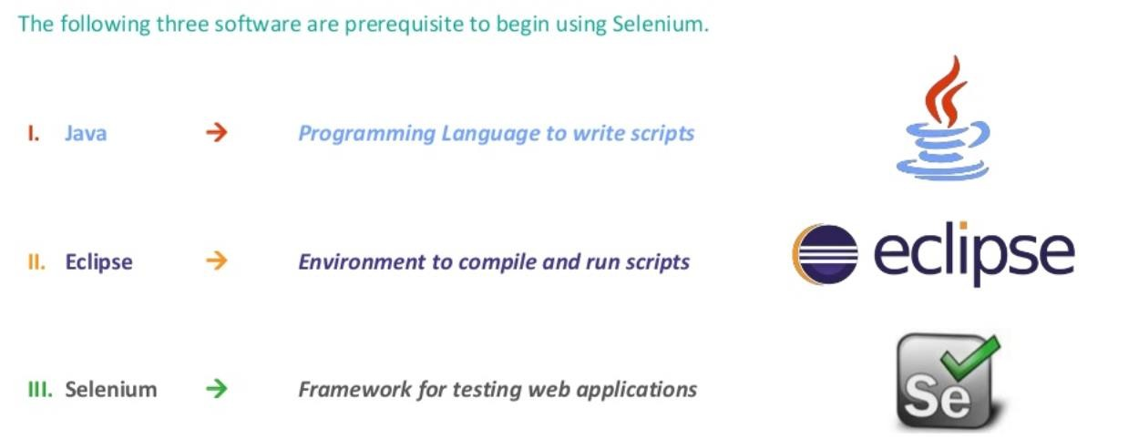
Setting up Selenium

Slide 27
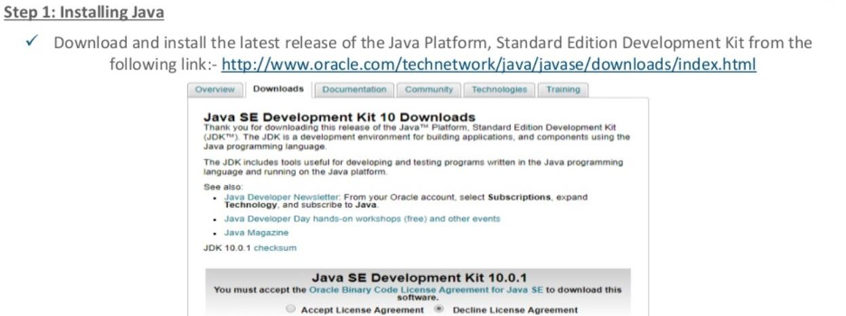
Setting up Selenium

Slide 28
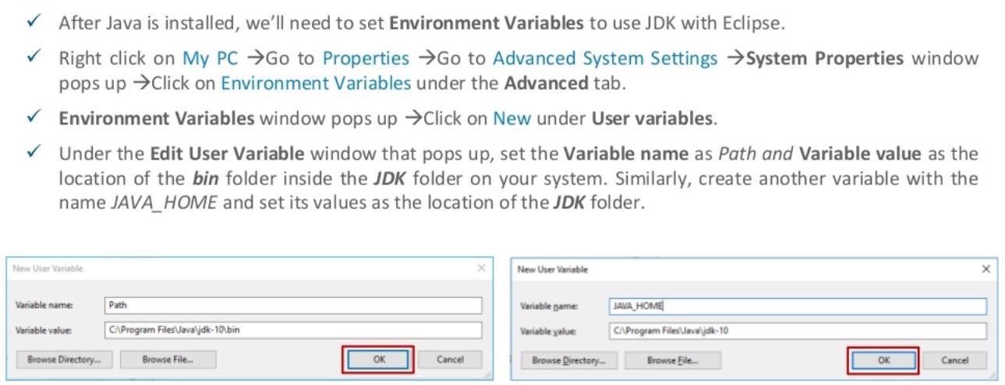
Setting up Selenium

Slide 29
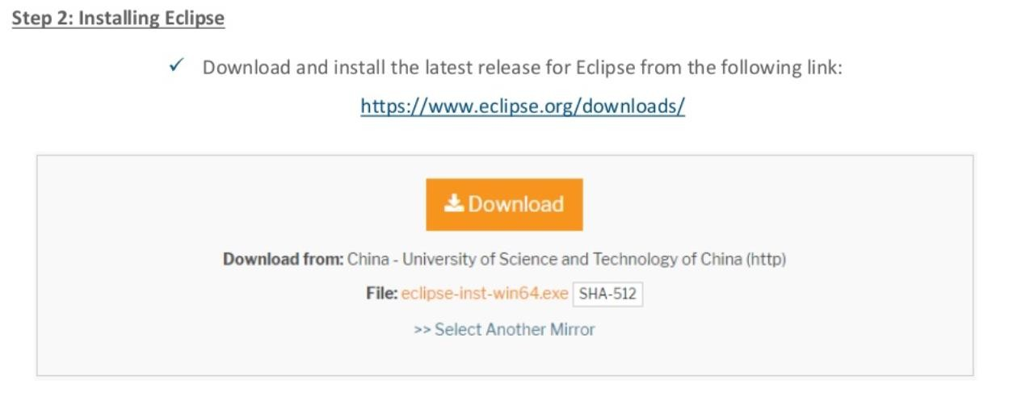
Setting up Selenium

Slide 30
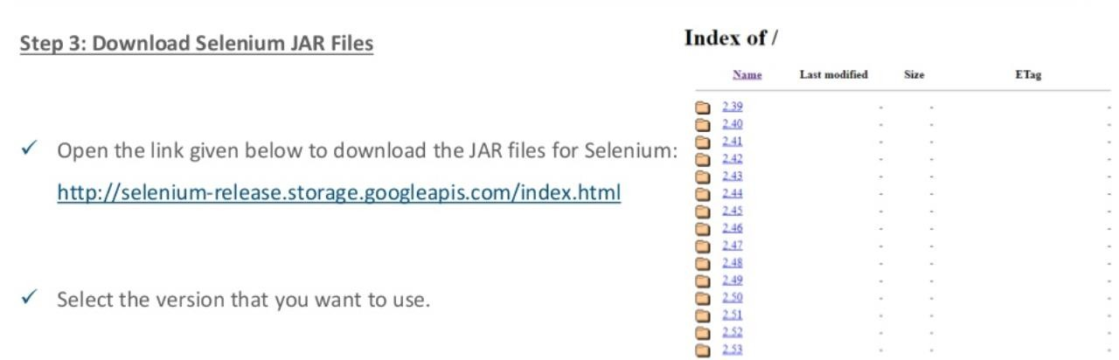
Setting up Selenium

Slide 31
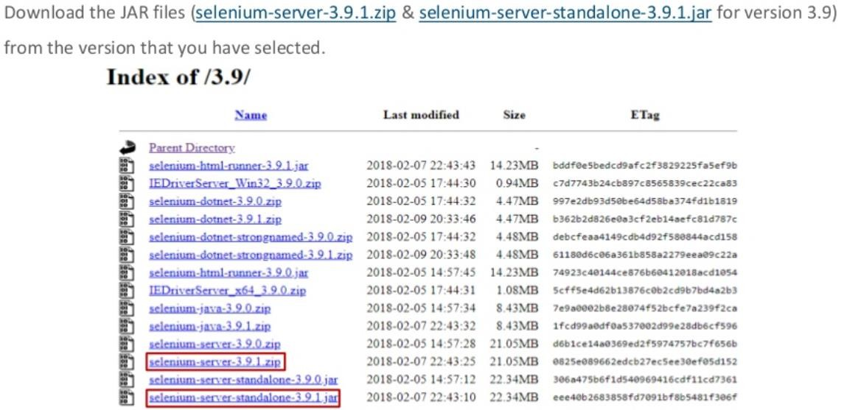
Setting up Selenium

Slide 32
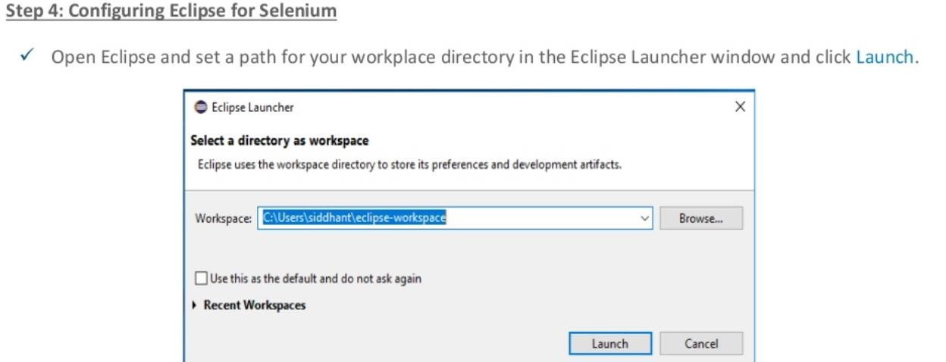
Setting up Selenium

Slide 33
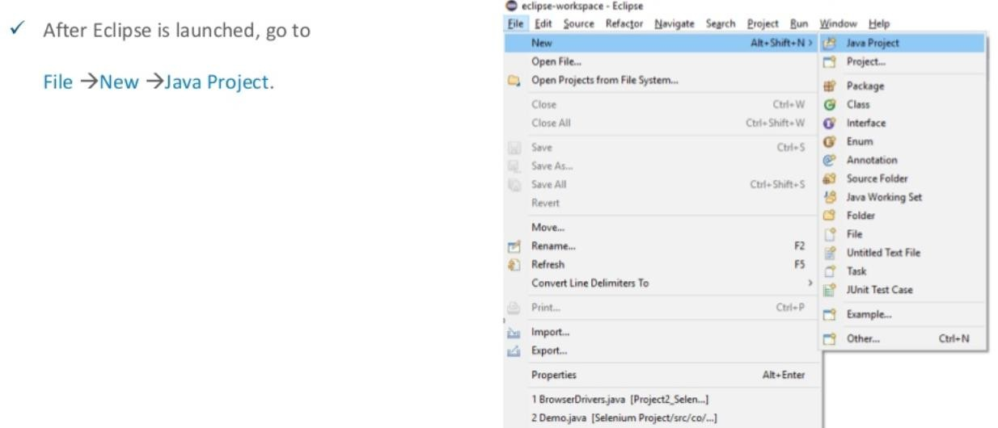
Setting up Selenium

Slide 34
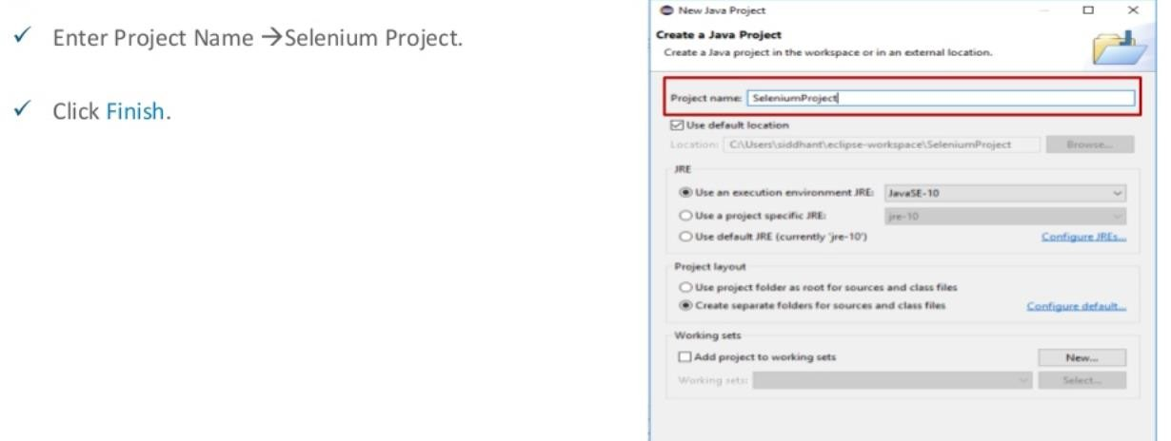
Setting up Selenium

Slide 35
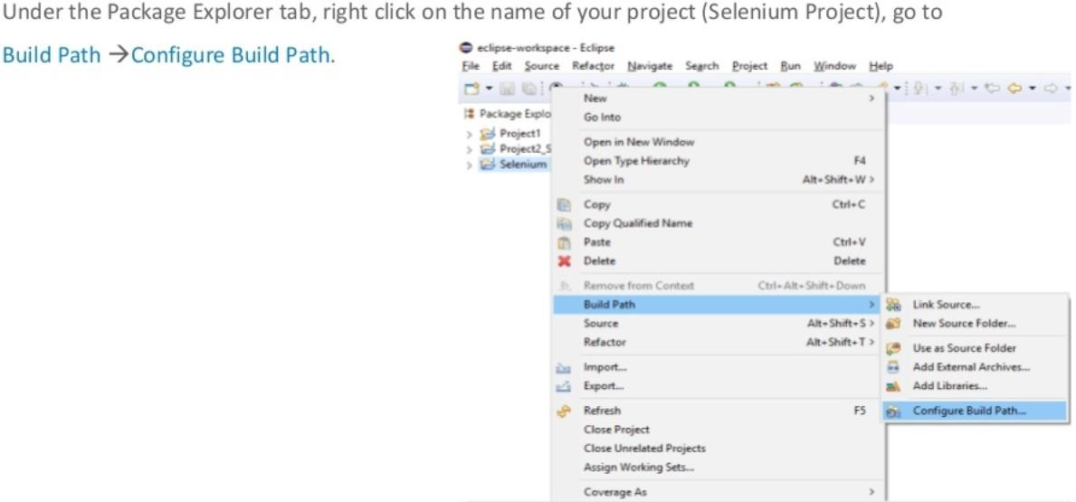
Setting up Selenium

Slide 36
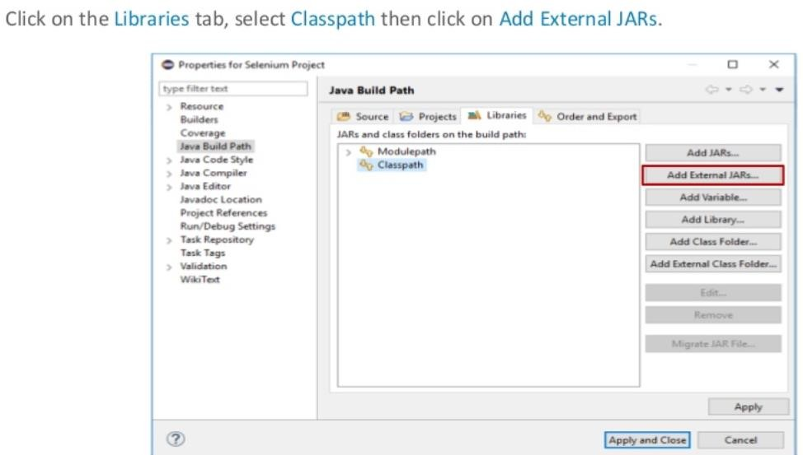
Setting up Selenium

Slide 37
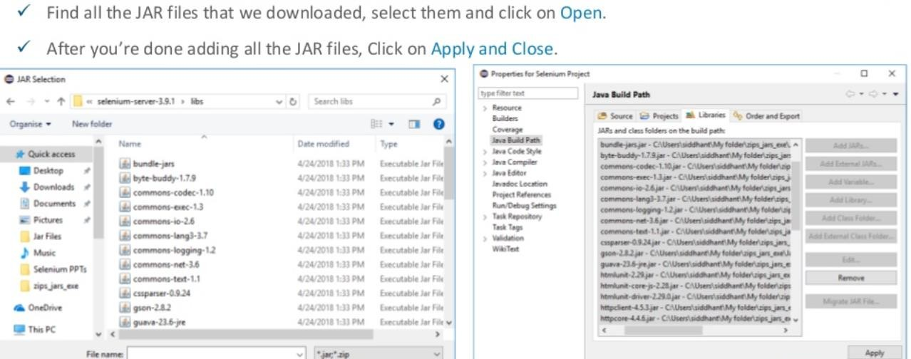
Setting up Selenium

Slide 38
THANK YOU

Slide 39
Apache JMeter and BlazeMeter

Slide 40
What is Apache JMeter?
Apache JMeter Java application is an open source software
Used to load test functional behavior and measure performance.
Used to test performance both on static and dynamic resources & Web dynamic applications.
Is used to simulate a heavy load on a server, group of servers, network or object to test its strength or to analyze overall performance under different load types.

Slide 41
Features of Apache JMeter
Ability to load and performance test many different applications/server/protocol types:
Web - HTTP, HTTPS (Java, NodeJS, PHP, ASP.NET, …)
SOAP / REST Webservices
FTP
Database via JDBC
LDAP ..etc
Full featured Test IDE that allows fast Test Plan recording , building and debugging.
A complete and ready to present dynamic HTML report
Easy correlation through ability to extract data from most popular response formats, HTML, JSON , XML etc..
Complete portability and 100% Java purity.

Slide 42
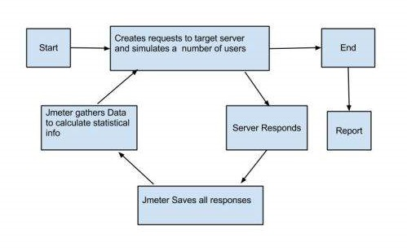
Working of JMeter

Slide 43
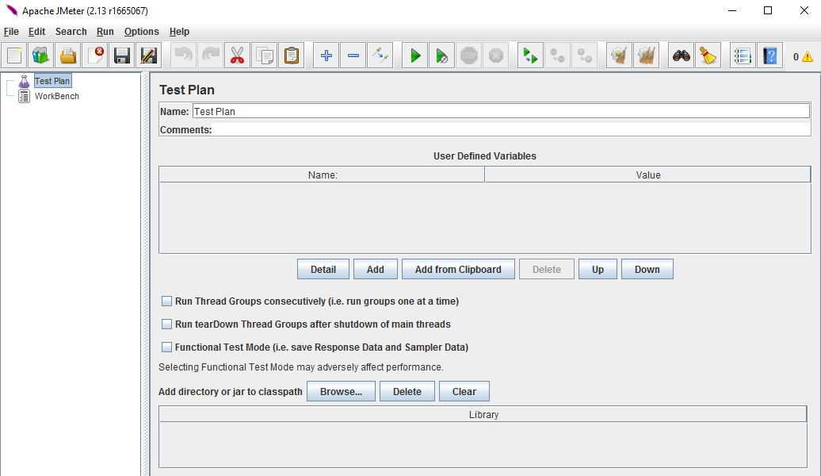
JMeter in GUI Mode

Slide 44
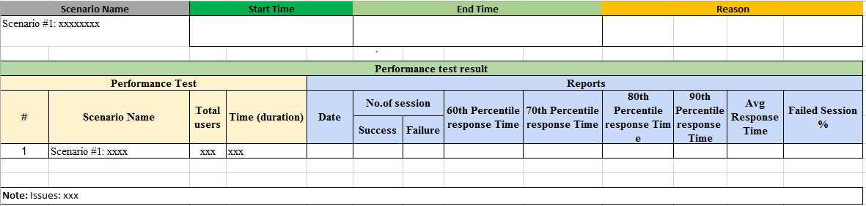
Scenarios for Testing

Slide 45
What is BlazeMeter
Commercial, self-service load testing platform as a service (PaaS), which is compatible with open-source Apache JMeter
The BlazeMeter platform is a program for comprehensive web testing and checking the load functionality of different software..
With this program, developers and testers can do the following:
Create a real model of users’ behavior with a product under test;
Use further capabilities of test scripts and test loads on clients’ requests;
Make complex interactive reports in a real-time mode.

Slide 46
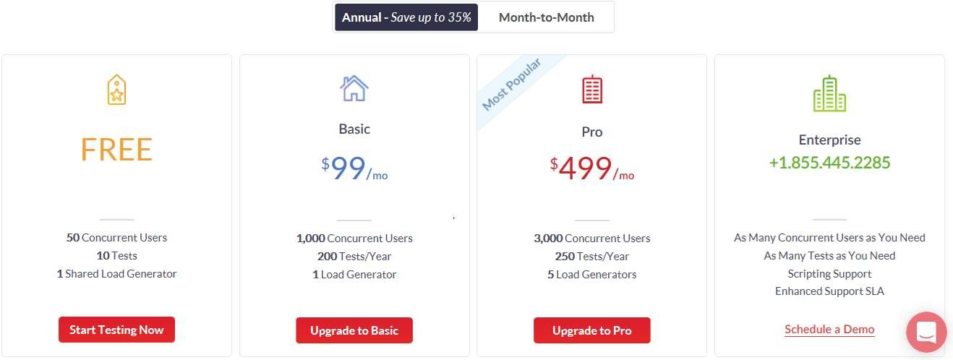
BlazeMeter Purchase Plans

Slide 47
Features of BlazeMeter
Open source with
high functionality
Recording and extend a test script
Cross-platform
Benefits
Execute real-world
Data-driven tests

Slide 48
Benefits of BlazeMeter
Allows to use different scenarios of load testing with any number of test steps.
Detailed interactive reports, especially performance reports which are presented in a convenient and easily understandable form.
A user can receive detailed performance reports on each test session that allows analyzing the load and searching for critical vulnerabilities in the software under test.
Full management and regulation of tests. A user can view reports and key performance indicators in a real-time mode (from CPU load to system capacity).
All tests are saved in a special repository that allows a user to work with its data at any time (to compare completed tests for various periods of time).

Slide 49
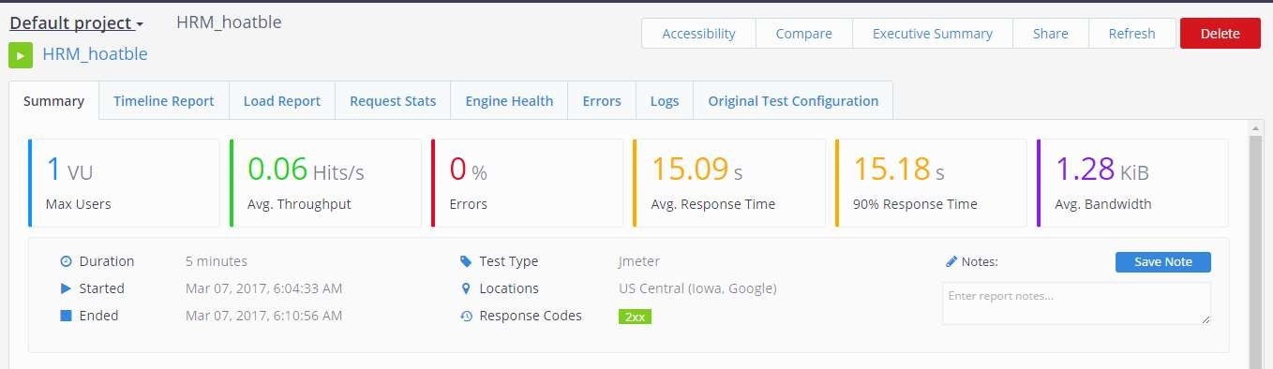
Performance Test Results
14

Slide 50
THANK YOU
75

